Slide 1

Chapter 14
Testing

Slide 2

Objectives
This chapter introduces you to the concept of testing Django web applications.
You will learn about the importance of testing in software development and, more importantly, in building web applications.
You will write unit tests for your Django application's components, such as views, models, and endpoints.

Slide 3
The Importance of Testing
Ensuring that the components of the application work according to specifications.
Ensuring interoperability with different infrastructure platforms: if an application can be deployed on a different operating system, such as Linux, Windows, and so on.
Reducing the probability of introducing a bug while refactoring the application code.

Slide 4
Automation Testing
Automation testing can be broadly categorized into five different types:
Unit Testing: In this type of testing, the individual isolated units of code are tested. For example, a unit test can target a single method or a single isolated API.

Slide 5
Automation Testing
Integration Testing: In this type of testing, the individual isolated units of code are merged to form a logical grouping.
Functional Testing: In this kind of testing, the overall functionality of the different components of the application is tested.

Slide 6
Automation Testing
Smoke Testing: In this kind of testing, the stability of the deployed application is tested to make sure that the application continues to remain functional as users interact with it.

Slide 7
Automation Testing
Regression Testing: This kind of testing is done to make sure that the changes being made to the application do not degrade the previously built functionality of the application.

Slide 8
Testing in Django

Slide 9
Unit Testing in Django
A TestCase class, which wraps the different test cases that are grouped for a given module.
An actual test case, which needs to be executed to test the flow of a particular component.

Slide 10

Unit Testing in Django
Once these unit tests are written, they can also be executed easily by running them directly using the provided test command in manage.py as follows:

Slide 11

Utilizing Assertions
Import the unittest module, which allows us to build the test cases.

Slide 12
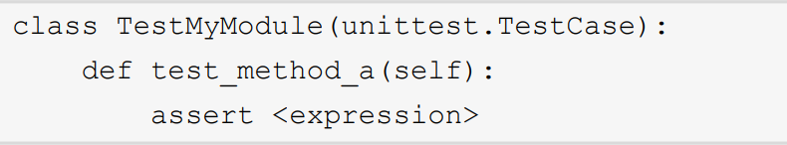
Utilizing Assertions
Once the module is imported, you can create a class whose name starts with Test, which inherits from the TestCase class provided by the unittest module.

Slide 13
Types of Assertions
assertIsNone: This assertion is used to check whether an expression evaluates to None or not.
assertIsInstance: This assertion is used to validate whether a provided object evaluates to an instance of the provided type.

Slide 14
Types of Assertions
assertEquals: This is a very basic function that takes in two arguments and checks whether the provided arguments to it are equal in value or not.
assertRaises: This method is used to validate whether the name of the method provided to it when called raises a specified exception or not.

Slide 15
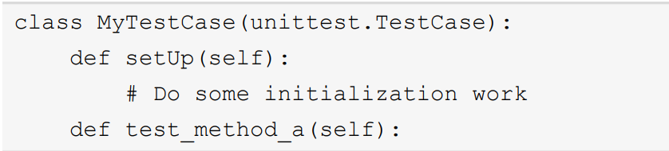
Performing Pre-Test Setup and Cleanup after Every Test Case Run
For example, the following example illustrates a simple definition of how the setUp() method is used inside a TestCase class.

Slide 16
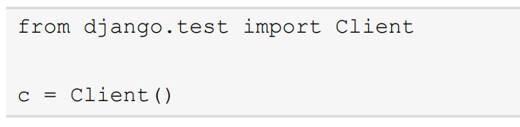
Testing Django Views
Client can be used by importing the Client class from the Django test module and then initializing it as shown in the following snippet:

Slide 17
Testing Django Views
The client object supports several methods that can be used to simulate the different HTTP calls a user can make, namely, GET, POST, PUT, DELETE, and so on.

Slide 18
Testing Views with Authentication
The following code snippet shows how you can set up Django's test client to simulate a logged-in user:

Slide 19
SimpleTestCase
The ability to check for exceptions raised by a view function.
The ability to test form fields.
A built-in test client.
The ability to verify a redirect by a view function.
Matching the equality of two HTML, JSON, or XML outputs generated by the view functions.

Slide 20
TransactionTestCase
The ability to reset the database to a default state before a test case runs.
Skipping tests based on database features – this feature can come in handy if the database being used for testing does not support all the features of a production database.

Slide 21
Writing tests
In this example, we're using the setUp method to create a test instance of MyModel with some dummy data. We're also using the tearDown method to delete the test instance after the tests are run.

Slide 22
Writing tests
We're then defining two test methods: test_my_model_fields and test_my_model_str. In test_my_model_fields, we're testing whether the fields of the test instance match the expected values. In test_my_model_str, we're testing whether the __str__ method of the test instance returns the expected string.

Slide 23
Writing tests
We're then defining two test methods: test_my_model_fields and test_my_model_str. In test_my_model_fields, we're testing whether the fields of the test instance match the expected values. In test_my_model_str, we're testing whether the __str__ method of the test instance returns the expected string.

Slide 24
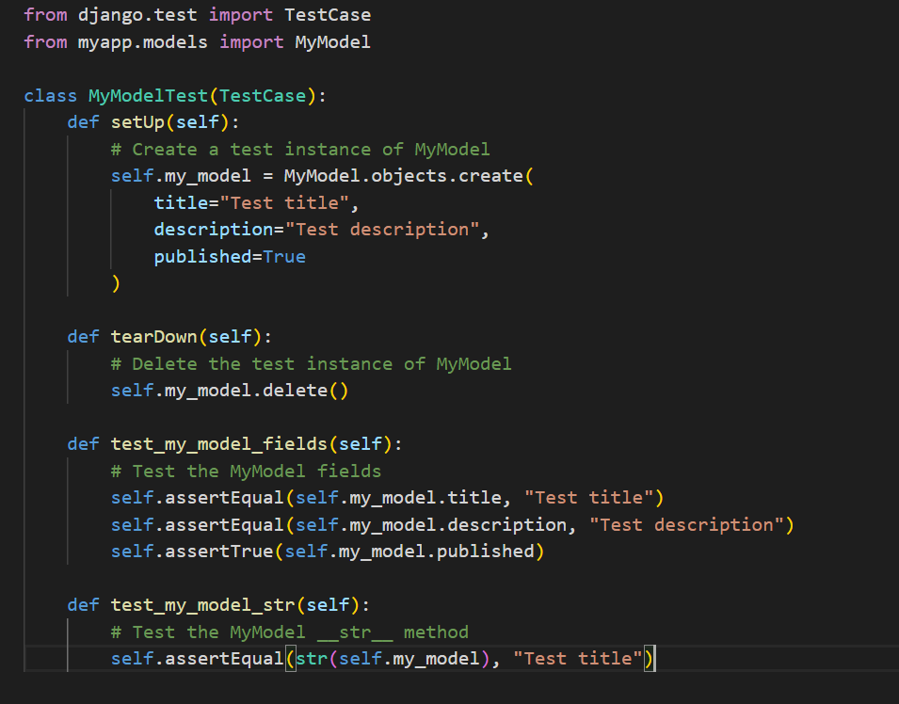
Writing tests

Slide 25
Summary
Throughout this chapter, we looked at how we can write test cases for different components of our web application project with Django.
We learned about why testing.
We then looked at how we can use the TestCase class provided by Django's test

